Slide 1

7th Grade Math
Unit 1, Lesson 1 Statistics and Interpreting Data Volume 1, pg. 5

Slide 2


Benchmarks
6.DP.1.1
Recognize and formulate a statistical question
that would generate numerical data.
6.DP.1.4
Given a histogram or line plot within a real-
world context, qualitatively describe and
interpret the spread and distribution of the
data, including any symmetry, skewness, gaps,
clusters, outliers, and the range.
volume 1, pg. 5

Slide 3
Integrated Mathematical Thinking and Reasoning Standards
MA.K12.MTR.2.1 Demonstrate understanding by representing problems in multiple ways.
MA.K12.MTR.4.1 Engage in discussions that reflect on the mathematical thinking of self and others.
volume 1, pg. 5

Slide 4

Learning Targets
I can identify statistical questions and classify types of data.
I can interpret information from a data set or a graphical display.
volume 1, pg. 5

Slide 5

Warm-Up
volume 1, pg. 5

Slide 6
1.1.1 Warm-Up: Day in the Life of a Mushroom Farmer
Alejandro, a mushroom-kit entrepreneur, says that when it comes to growing his business, “The most important thing is … adapting opportunities that come to you and still holding the same amount of passion.”
What is something you are passionate about?
How has a new interest or hobby surprised you?
volume 1, pg. 5

Slide 7

Refresher
volume 1, pg. 6

Slide 8


1.1.2 Refresher: Defining a Statistical Question
A statistical question is a question that can be answered by collecting data. Often, there will be variability in the data.
Examples and non-examples of statistical questions are shown.
Statistical Questions | NOT Statistical Questions
How many siblings do the students in my class have? How tall are the players on the girls’ basketball team? What is the favorite song of the 6th graders at my school? | What time does school start? Who is the President of the United States? What is Avery’s favorite color?
volume 1, pg. 6

Slide 9
What do you notice about the two types of questions?
What do you think “variability in the data” means in the definition of “statistical question?”
Explain why the question, “How many times do the students at my school go swimming this summer?” is a statistical question.
volume 1, pg. 6

Slide 10

Try It
volume 1, pg. 6

Slide 11

1.1.3 Try It: Identifying Statistical Questions
Sort the following questions into the appropriate column by writing the letters of the questions in the table provided.
How many miles do the students in my class live from the school campus?
How many counties are there in Florida?
Who is the governor of Florida?
How many siblings do my 7th grade teachers have?
How many hours do adults in Florida spend outdoors on a weekend?
How many days are in December?
volume 1, pg. 6

Slide 12
Statistical Questions | NOT Statistical Questions
volume 1, pg. 6

Slide 13
Refresher
volume 1, pg. 7

Slide 14
1.1.4 Refresher: Data Displays
Numerical data can be displayed graphically in a variety of ways. Three graphs that are commonly used are histograms, line plots, and box plots.
volume 1, pg. 7

Slide 15
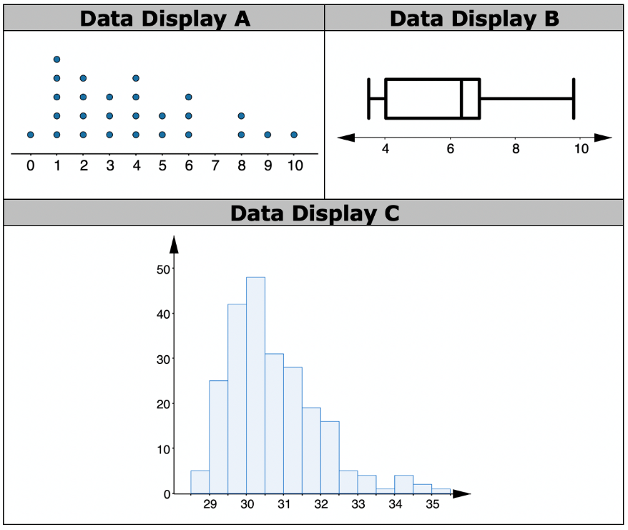
Three data displays are shown below. Match each type of data display with the examples shown by writing the letter on the line.
Histogram ____ Line Plot ____ Box Plot ____
volume 1, pg. 7

Slide 16

Guided Instruction
volume 1, pg. 7

Slide 17
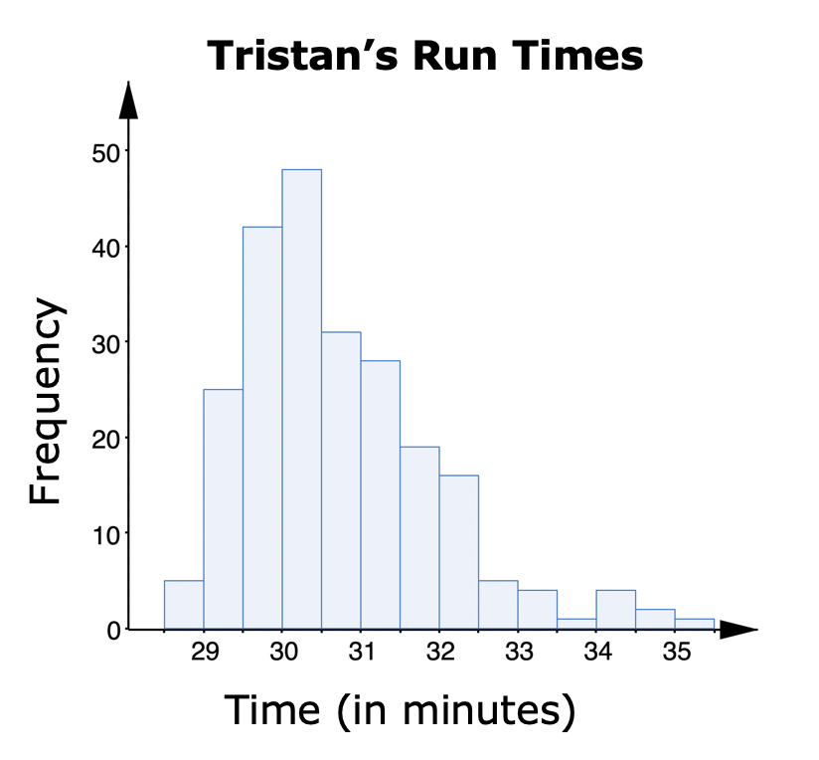
1.1.5 Guided Instruction: Interpreting Histograms and Line Plots
Tristan has been tracking the time, in minutes, it takes him to run 4 miles for the last 10 years. A histogram of Tristan’s run times is shown.
volume 1, pg. 7

Slide 18
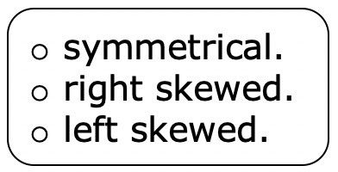

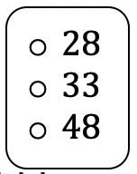
The shape of run times can be best described as
Tristan’s typical run time was about _________ minutes. Most of his run times were between ______ to ______ minutes. Not many of his runs were than 32.5 minutes.
If the data value was added to the histogram, it would be considered an outlier.
volume 1, pg. 7/8

Slide 19
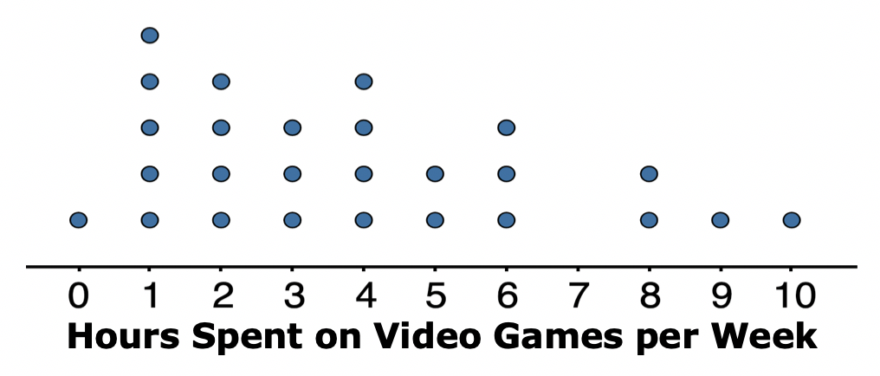
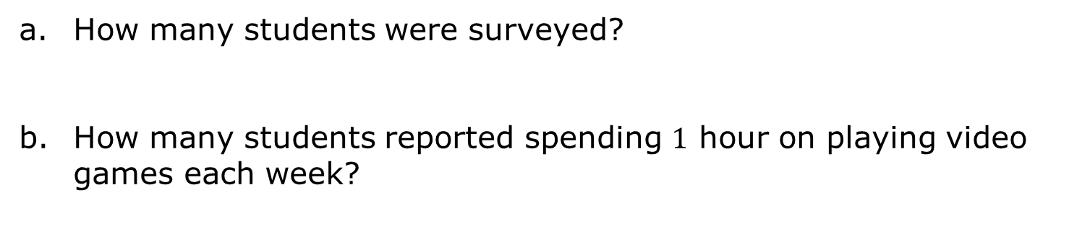
The line plot shows the number of hours per week that students reported playing video games.
How many students were surveyed?
How many students reported spending $1$ hour on playing video games each week?
volume 1, pg. 8

Slide 20
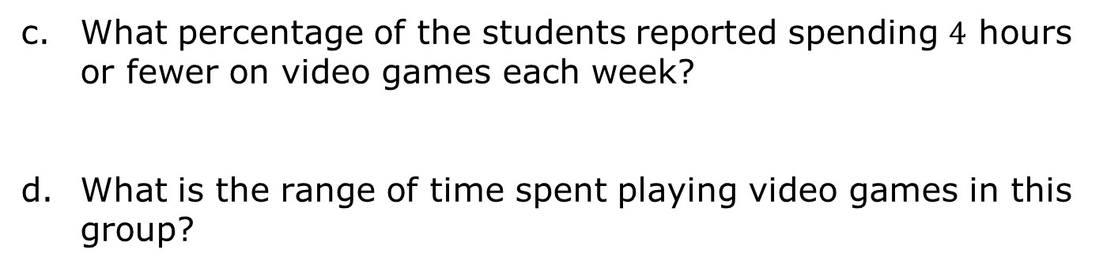
What percentage of the students reported spending $4$ hours or fewer on video games each week?
What is the range of time spent playing video games in this group?
volume 1, pg. 8

Slide 21

Collaboration
volume 1, pg. 8

Slide 22

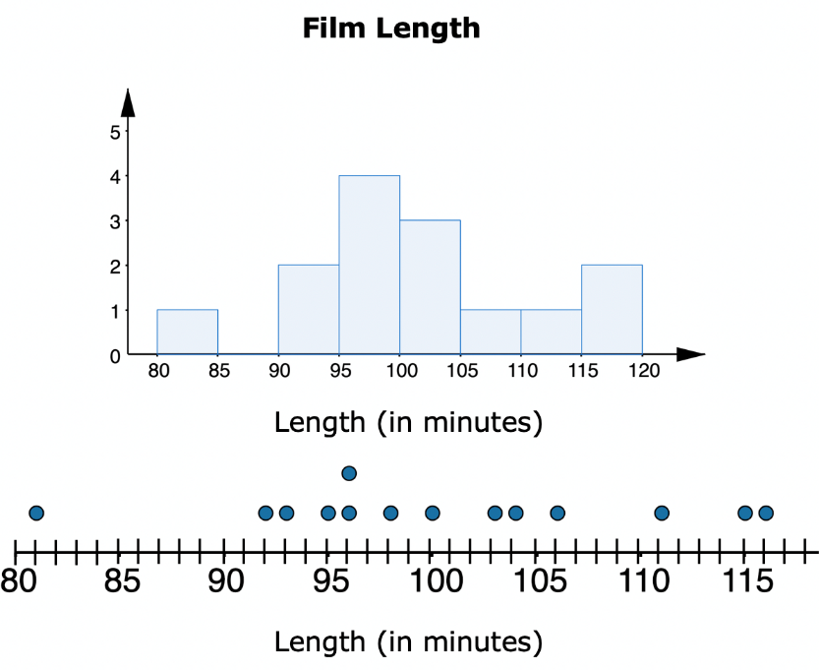
1.1.6 Collaboration: Which Graph?
A movie critic recorded the length, in minutes, of a sample of Pixar films and made a histogram and a line plot of the data.
volume 1, pg. 8

Slide 23
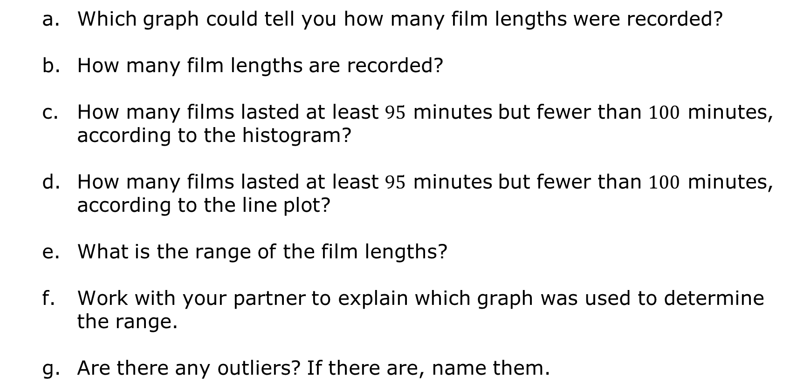
Which graph could tell you how many film lengths were recorded?
How many film lengths are recorded?
How many films lasted at least $95$ minutes but fewer than $100$ minutes, according to the histogram?
How many films lasted at least $95$ minutes but fewer than $100$ minutes, according to the line plot?
What is the range of the film lengths?
Work with your partner to explain which graph was used to determine the range.
Are there any outliers? If there are, name them.
volume 1, pg. 8-9

Slide 24

Wrap-Up
volume 1, pg. 9

Slide 25
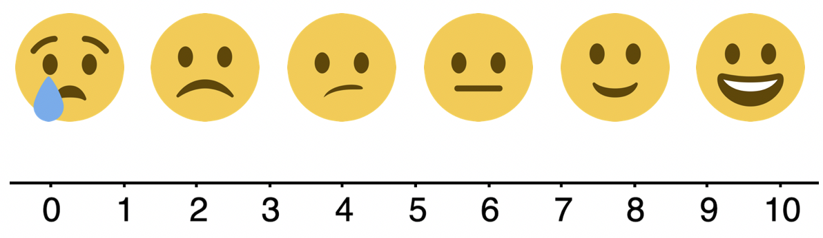
1.1.7 Wrap-Up: Reflection
Choose the emoji that reflects your understanding of statistics and interpreting data.
volume 1, pg. 9

